Slide 1
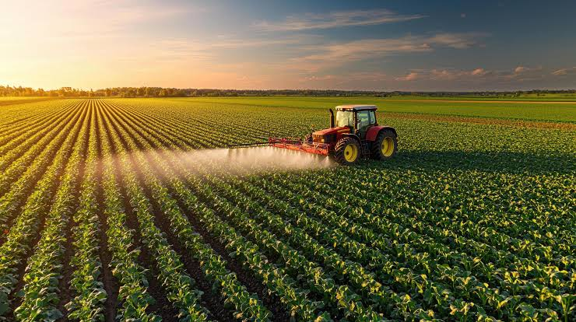

SMART AGRICULTURE MANAGEMENT SYSTEM
SQL Database Project
A relational database project using MySQL to manage farms,Lands, crops, production, market, Production, price and sales
PRESENTED BY
SASTHASAI V M

Slide 2





PROJECT OVERVIEW
The Smart Agriculture Management System is designed to digitize and streamline agricultural operations. It helps in managing farmers, lands, crops, seasons, suppliers, production, market prices and sales data in an integrated manner
FARMER & LAND CROP & SEASON PRODUCTION MARKET PRICE SALES
MANAGEMENT MANAGEMENT TRACKING MONITORING MANAGEMENT
Key Benefits :
Centralized data management.
Accurate tracking of production and sales·
Real-time market price monitoring.
Better decision making for farmers and stakeholders.

Slide 3
PROJECT OBJECTIVES
Digitize agricultural data management.
Reduce data redundancy.
Maintain data integrity using Primary and Foreign Key constraints.
Track production, market prices, and sales.
Generate analytical reports for better decision-making.

Slide 4
APPLICATIONS AND QUERIES USED
MySQL – Used as the relational database management system to store and manage all project data.
Standard SQL – Used to design, manipulate, and query the database.
MySQL Workbench – Used as the development environment to create tables, insert data, and execute SQL queries.
DBEAVER – Used as an IDE for writing queries
Data Definition Language (DDL) – CREATE TABLE statements were used to define the database structure.
Data Manipulation Language (DML) – INSERT, UPDATE, and DELETE statements were used to add, modify, and remove records.
Data Query Language (DQL) – SELECT statements were used to retrieve and display data.
Joins – Used to combine related data from multiple tables.
Aggregate Functions – COUNT() and SUM() were used to generate summaries and reports.
GROUP BY – Used to organize data into categories for analysis.
HAVING – Used to filter grouped data based on specific conditions.
ORDER BY – Used to sort query results in ascending or descending order.
Date Functions – DATE_FORMAT() was used to format and analyze date values.
Relational Database Concepts – Primary keys and foreign keys were used to establish relationships and maintain data integrity

Slide 5
DATABASE TABLES AND DESCRIPTION
TABLE | DESCRIPTION
FARMER | Stores farmer personal and contact details.
LAND | Stores land information and is linked to farmers.
CROP | Stores crop details including category, duration and water requirement.
SEASON | Stores seasonal information (kharif, rabi, zaid).
SUPPLIER | Stores supplier details for inputs and services.
PRODUCTION | Tracks production activities on lands with crops and suppliers.
MARKET | Stores market details and contact information.
MARKET PRICE | Stores daily crop prices for different markets.
SALES | Tracks crop sales from production to markets.

Slide 6
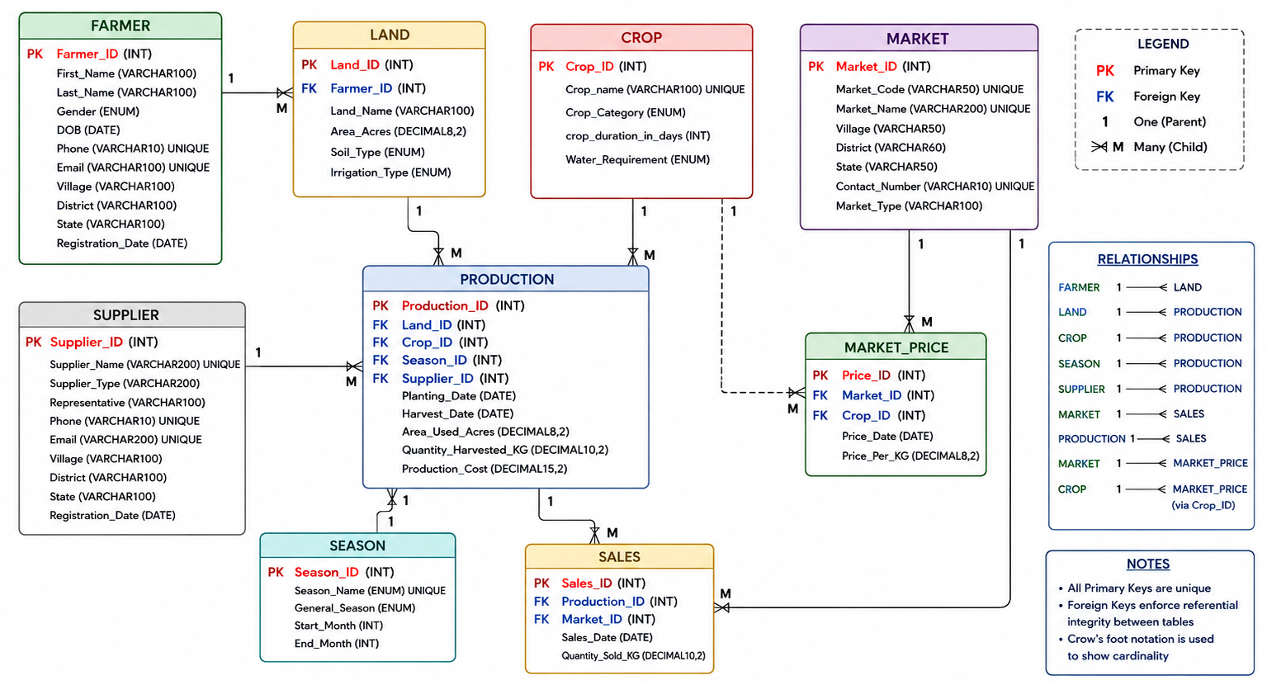
DATABASE ER DIAGRAM

Slide 7
DATABASE STATISTICS
Metric | Value
Total Tables | 9
Primary Keys | 9
Foreign Keys | 9
Relationships | 9
SQL Queries Written | 80+
Database Views | 5
Market Price Records | 100,000+

Slide 8
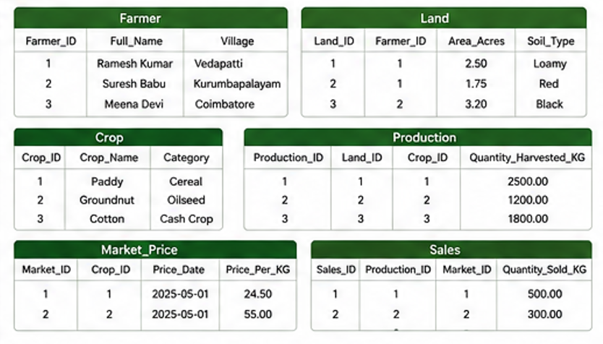
SAMPLE DATA SNAPSHOT

Slide 9
CRUD OPERATIONS
DELETE FROM Supplier
WHERE
Supplier_ID = 100 ;
INSERT INTO Farmer
(First_Name,Last_Name,
Gender,DOB,Phone,
Email,Village,District,
State)
VALUES(‘RAMESH’,
‘KUMAR’,’MALE’,
1999-01-01’,
’0123456789’,
’RK@gmail.com’,
‘VEDAPATTI’,
’COIMBATORE’,
‘TAMIL NADU’
DELETE
CREATE
UPDATE Land set
Area_Acres = 3.00
WHERE Land_ID = 1
SELECT First_Name,
Last_Name,CONCAT(
First_Name,” ”,
Last_Name) as Full_Name FROM
Farmer WHERE State=‘Coimbatore’;
UPDATE
READ
These operations confirm that the database supports complete data management functionality.

Slide 10
SAMPLE ANALYTICAL QUERIES
Total number of farmers by state
SELECT state, COUNT(*) AS total_farmers FROM farmer GROUP BY state
ORDER BY total_farmers DESC;
Top 5 crops by total production
SELECT c.Crop_Name, SUM(p.Quantity_Harvested_KG) AS Total_Production
FROM production p
JOIN crop c ON p.Crop_ID = c.Crop_ID GROUP BY c.Crop_Name
ORDER BY Total_Production DESC LIMIT 5;
Average market price of each crop
SELECT c.Crop_Name, AVG(mp.Price_Per_KG) AS Avg_Price FROM market_price mp JOIN crop c ON mp.Crop_ID = c.Crop_ID
GROUP BY c.Crop_Name;

Slide 11

PROJECT OUTCOME
Organized and integrated agricultural data management system
Accurate tracking of production, prices and sales
Helps farmers and stakeholders to make decisions on their own
Scalable and can be extended with more modules like weather, inventory, loans etc..,

Slide 12
CONCLUSION
The Smart Agriculture Management System demonstrates how SQL can be used to build a real-world, data-driven solution for the agriculture sector. This system improves transparency, efficiency, and productivity by connecting farmers, markets, suppliers, and private companies through a centralized platform.
Future Enhancements
Power BI Dashboard
Mobile Application
Loan Management
Crop Recommendation using AI

Slide 13
THANK YOU

